Slide 1

Real-Time Analytics in Fabric
Kristyna Ferris

Slide 2

About Me ~ Kristyna Ferris
Microsoft MVP, Data Platform Solution Architect, P3 Adaptive Lexington Data Tech Group co-organizer Co-author on DataOnWheels
Blog - https://dataonwheels.wordpress.com/ LinkedIn - https://www.linkedin.com/in/kristyna-ferris-dataonwheels/
Twitter - @data_dragoness

Slide 3

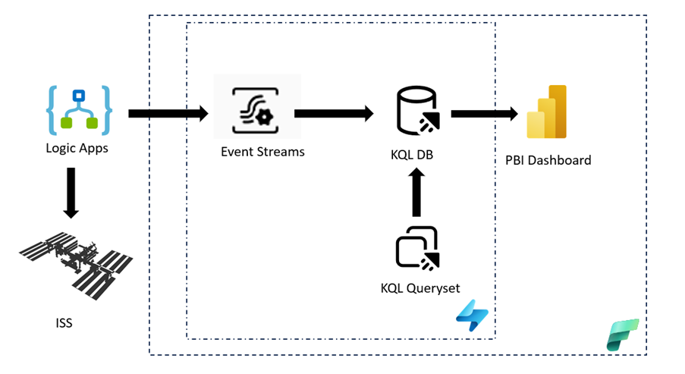
Architecture

Slide 4

Prerequisites
Fabric capacity backed workspace
Streaming data source
Notes:
Don’t be afraid to try this yourself!
An F2 capacity is very cheap, especially if you pause it when you’re not using it.

Slide 5
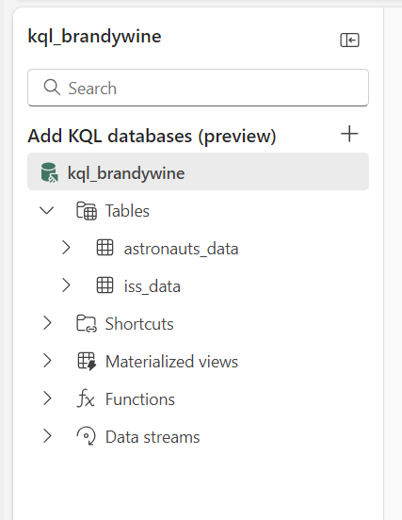
Create KQL Database
This step is easier than you think! All you need to do is come up with a fun name.
We will not be creating any tables at this stage as those will be added from the Event Streams.
Notes:
Don’t worry about making tables, we will do that during the event stream creation.

Slide 6


Slide 7
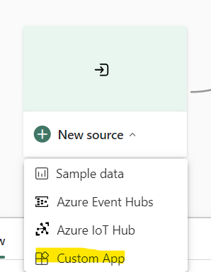
Create Event Streams
We have two sources of data (astronauts and ISS location).
So, we need two Event Streams to capture that data.
The source will be a custom app. Hold off on making the destination until after we make the Logic Apps.

Slide 8
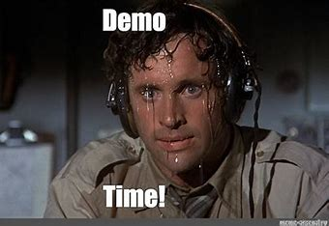

Slide 9
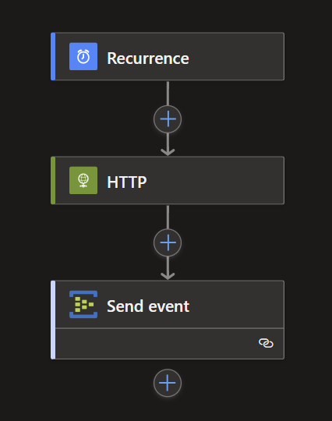
Create Logic Apps
Navigate to Azure Portal
Create 2 Logic Apps
Don’t forget to add the body of the HTTP response to the Send Event action
Must be a consumption plan
Notes:
This is our only non-Fabric piece of the puzzle.
We will be using free, anonymous REST API to connect to ISS data.
Make sure the logic app is a Consumption app, NOT standard.

Slide 10


Slide 11
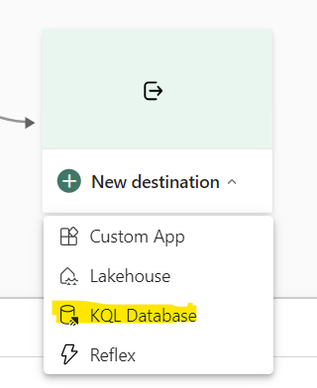
Finish Event Streams
Go back to the event streams and connect them to the KQL database.
This will create the tables we will use in Power BI.
Make sure to use the event processing before ingestion option for data ingestion mode.

Slide 12
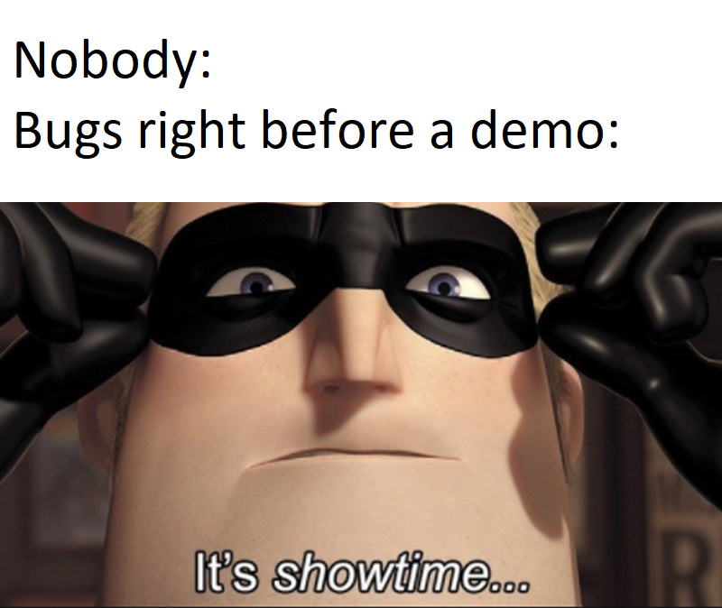

Slide 13

Query the Data
KQL is not SQL!
There are 3 types of KQL queries (tabular, let, and set). We will focus on tabular.
The basic syntax of a tabular query is:
TABLE
| operator statement 1
| operator statement 2
Notes:
KQL quick reference: KQL quick reference - Azure Data Explorer & Real-Time Analytics | Microsoft Learn
KQL tutorial: Tutorial: Learn common Kusto Query Language operators - Azure Data Explorer & Real-Time Analytics | Microsoft Learn
ago() - Azure Data Explorer & Real-Time Analytics | Microsoft Learn

Slide 14


Slide 15
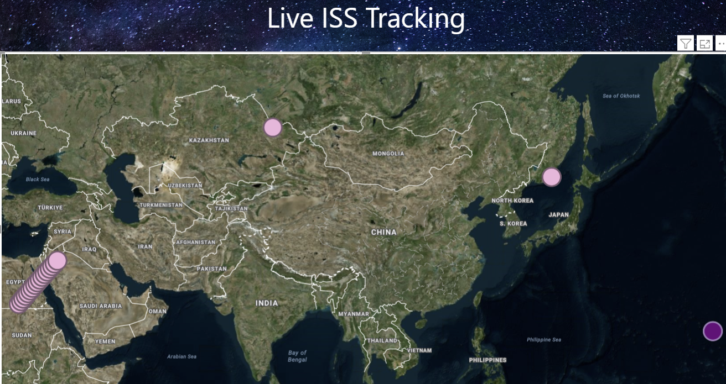
Create Power BI Report
Let’s pull in our latest timestamps to see the latest positions of the ISS.
By enabling the page refresh, we can see it move in near real time!

Slide 16


Slide 17

Questions?

Slide 18

Don’t forget to connect, thanks for listening!
https://dataonwheels.wordpress.com/
kristyna@dataonwheels.com
@data_dragoness
GitHub

